Slide 1
ANOVA
Lightboard

Slide 2
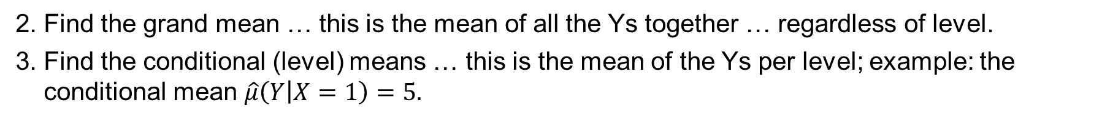
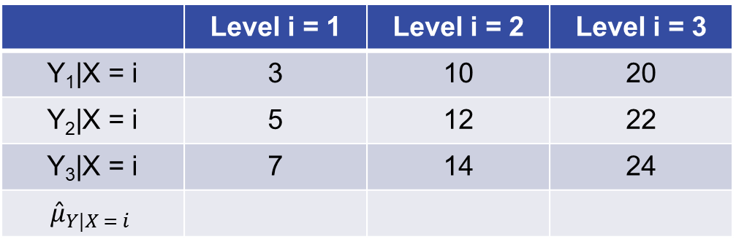

ANOVA
1. Make a scatterplot of the data in the table below. “Level” is the explanatory variable (X = 1, 2, or 3).
 | Level i = 1 | Level i = 2 | Level i = 3
Y₁|X = i | 3 | 10 | 20
Y₂|X = i | 5 | 12 | 22
Y₃|X = i | 7 | 14 | 24
$${\hat{μ}}_{Y|X = i}$$
$$\hat{μ}=\overset{̿}{x}=$$
2. Find the grand mean … this is the mean of all the Ys together … regardless of level.
3. Find the conditional (level) means … this is the mean of the Ys per level; example: the conditional mean $\hat{μ}\left(Y | X=1\right)=5.$

Slide 3

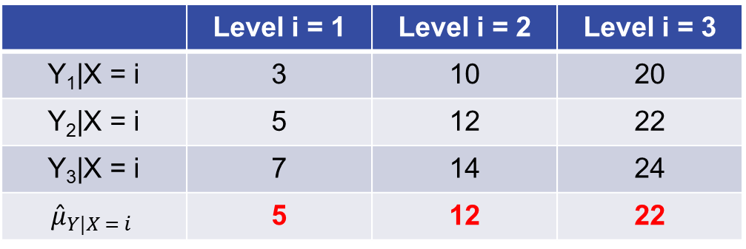
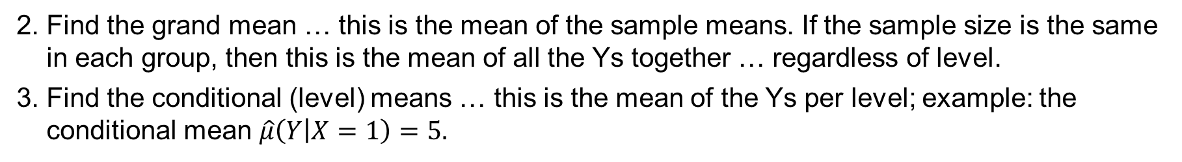
ANOVA (cont.)
1. Make a scatterplot of the data in the table below. “Level” is the explanatory variable (X = 1, 2, or 3).
 | Level i = 1 | Level i = 2 | Level i = 3
Y₁|X = i | 3 | 10 | 20
Y₂|X = i | 5 | 12 | 22
Y₃|X = i | 7 | 14 | 24
$${\hat{μ}}_{Y|X = i}$$ | 5 | 12 | 22
$$\hat{μ}=\overset{̿}{x}=\text{13}$$
2. Find the grand mean … this is the mean of the sample means. If the sample size is the same in each group, then this is the mean of all the Ys together … regardless of level.
3. Find the conditional (level) means … this is the mean of the Ys per level; example: the conditional mean $\hat{μ}\left(Y | X=1\right)=5.$

Slide 4

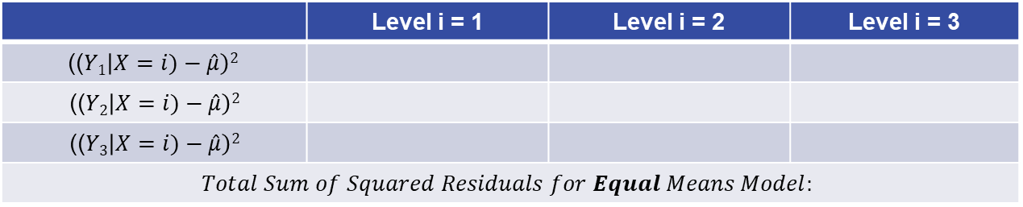
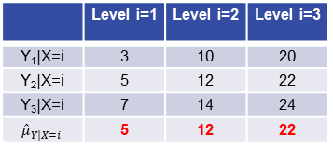
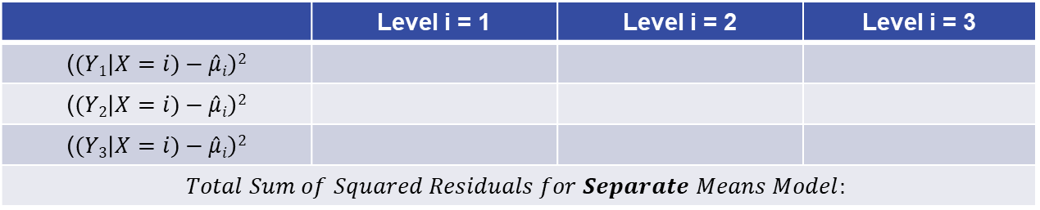
Pure ANOVA, Part I
 | Level i=1 | Level i=2 | Level i=3
Y₁|X=i | 3 | 10 | 20
Y₂|X=i | 5 | 12 | 22
Y₃|X=i | 7 | 14 | 24
$${\hat{μ}}_{Y|X=i}$$ | 5 | 12 | 22
$$\hat{μ}=\overset{̿}{x}=\text{13}$$
4. Now we need to find the sum of the squared residuals for the equal means model.
($(Yi\left|X)−\hat{μ}\right)2$
 | Level i = 1 | Level i = 2 | Level i = 3
(($Y1\left|X=i)−\hat{μ}\right)2$
(($Y2\left|X=i)−\hat{μ}\right)2$
(($Y3\left|X=i)−\hat{μ}\right)2$
$$Total Sum of Squared Residuals for Equal Means Model:$$
5. Now we need to find the sum of the squared residuals for the separate means model, where $\hat{μ}i$ = $\hat{μ}(Y|X=i)$.
($(Yi\left|X=i)−\hat{μ}i\right)2$
 | Level i = 1 | Level i = 2 | Level i = 3
($(Y1\left|X=i)−\hat{μ}i\right)2$
($(Y2\left|X=i)−\hat{μ}i\right)2$
($(Y3\left|X=i)−\hat{μ}i\right)2$
$$Total Sum of Squared Residuals for Separate Means Model:$$
6. Compare the total sum of squares for each model. Which do you think “fits” better?

Slide 5
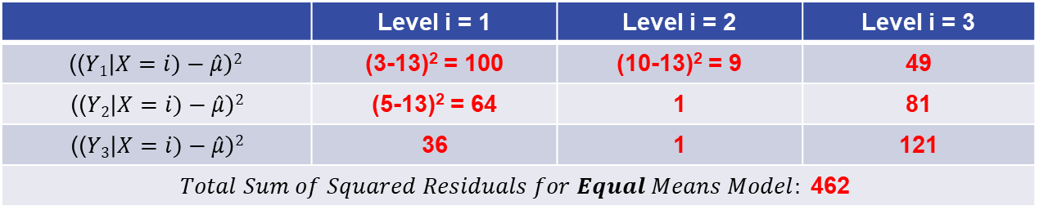
Pure ANOVA, Part II
 | Level i=1 | Level i=2 | Level i=3
Y₁|X=i | 3 | 10 | 20
Y₂|X=i | 5 | 12 | 22
Y₃|X=i | 7 | 14 | 24
$${\hat{μ}}_{Y|X=i}$$ | 5 | 12 | 22
$$\hat{μ}=\overset{̿}{x}=\text{13}$$
4. Now we need to find the sum of the squared residuals for the equal means model.
($(Yi\left|X)−\hat{μ}\right)2$
 | Level i = 1 | Level i = 2 | Level i = 3
(($Y1\left|X=i)−\hat{μ}\right)2$ | (3-13)² = 100 | (10-13)² = 9 | 49
(($Y2\left|X=i)−\hat{μ}\right)2$ | (5-13)² = 64 | 1 | 81
(($Y3\left|X=i)−\hat{μ}\right)2$ | 36 | 1 | 121
$$Total Sum of Squared Residuals for Equal Means Model:\text{ 462}$$
5. Now we need to find the sum of the squared residuals for the separate means model, where $\hat{μ}i$ = $\hat{μ}(Y|X=i)$.
($(Yi\left|X=i)−\hat{μ}i\right)2$
 | Level i = 1 | Level i = 2 | Level i = 3
($(Y1\left|X=i)−\hat{μ}i\right)2$
($(Y2\left|X=i)−\hat{μ}i\right)2$
($(Y3\left|X=i)−\hat{μ}i\right)2$
$$Total Sum of Squared Residuals for Separate Means Model:$$
6. Compare the total sum of squares for each model. Which do you think “fits” better?

Slide 6
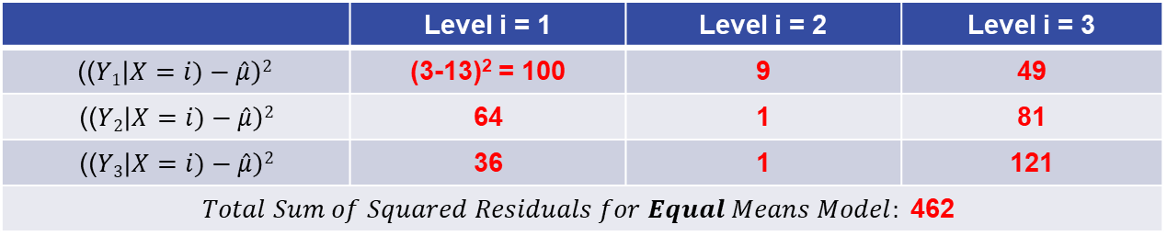
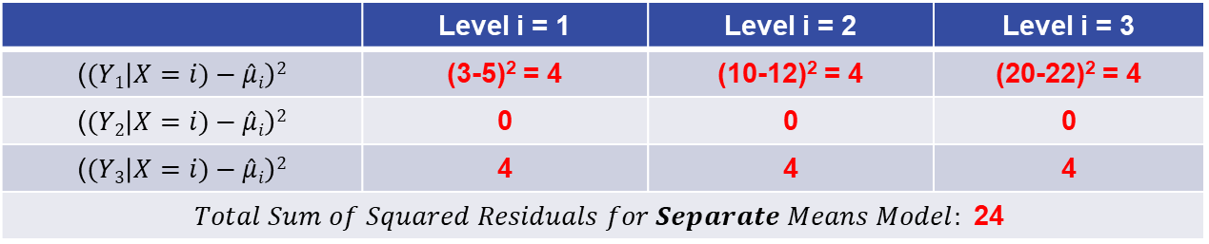
Pure ANOVA, Part III
 | Level i=1 | Level i=2 | Level i=3
Y₁|X=i | 3 | 10 | 20
Y₂|X=i | 5 | 12 | 22
Y₃|X=i | 7 | 14 | 24
$${\hat{μ}}_{Y|X=i}$$ | 5 | 12 | 22
$$\hat{μ}=\overset{̿}{x}=\text{13}$$
4. Now we need to find the sum of the squared residuals for the equal means model.
($(Yi\left|X)−\hat{μ}\right)2$
 | Level i = 1 | Level i = 2 | Level i = 3
(($Y1\left|X=i)−\hat{μ}\right)2$ | (3-13)² = 100 | 9 | 49
(($Y2\left|X=i)−\hat{μ}\right)2$ | 64 | 1 | 81
(($Y3\left|X=i)−\hat{μ}\right)2$ | 36 | 1 | 121
$$Total Sum of Squared Residuals for Equal Means Model:\text{ 462}$$
5. Now we need to find the sum of the squared residuals for the separate means model, where $\hat{μ}i$ = $\hat{μ}(Y|X=i)$.
($(Yi\left|X=i)−\hat{μ}i\right)2$
 | Level i = 1 | Level i = 2 | Level i = 3
($(Y1\left|X=i)−\hat{μ}i\right)2$ | (3-5)² = 4 | (10-12)² = 4 | (20-22)² = 4
($(Y2\left|X=i)−\hat{μ}i\right)2$ | 0 | 0 | 0
($(Y3\left|X=i)−\hat{μ}i\right)2$ | 4 | 4 | 4
$$Total Sum of Squared Residuals for Separate Means Model: \text{24}$$
6. Compare the total sum of squares for each model. Which do you think “fits” better?

Slide 7
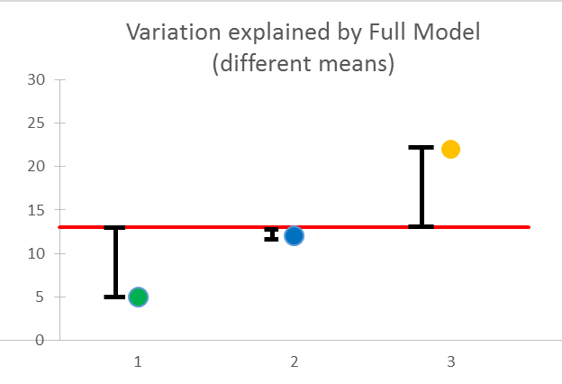
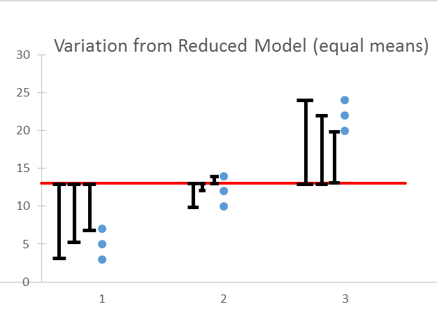
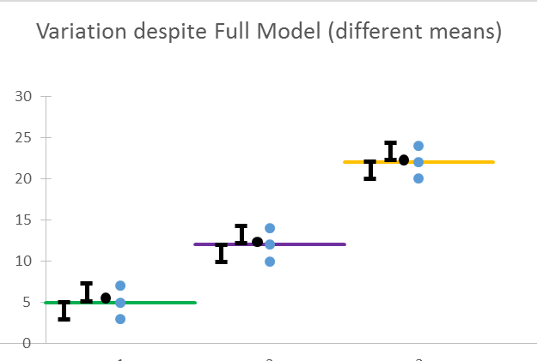
Sum of Squares in ANOVA
Between group variation (top row)
Total variation (bottom row)
Within group variation (middle row)
*To compute the sum of squares column for the ANOVA table, square each distance (lines in black) and then add.
The sum of squared* distances (black lines) for left two graphs = the sum of squared distances (black lines) for the right graph.
*Each distance squared for the top left graph is multiplied by the number in each group.

Slide 8
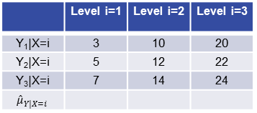
Pure ANOVA, Part I
 | Level i=1 | Level i=2 | Level i=3
Y₁|X=i | 3 | 10 | 20
Y₂|X=i | 5 | 12 | 22
Y₃|X=i | 7 | 14 | 24
$${\hat{μ}}_{Y|X=i}$$
7. Now we would like to make an ANOVA table to test the alternative hypothesis!
Formally write the H₀ and H_{a} and fill in the table.
 | df | SS | MS | F | Pr > F
Model/extra SS
Error/residual/full model
Total (reduced)
Extra sum of squares = residual sum of squares reduced – residual sum of squares full

Slide 9
Pure ANOVA, Part II
7. Now we would like to make an ANOVA table to test the alternative hypothesis!
Formally write the H_{o} and H_{a} and fill in the table.
H₀: µ₁= µ₂ = µ₃ (equal means model µ µ µ)
H_{a}: at least one pair is different (separate means model µ₁ µ₂ µ₃)
 | df | SS | MS | F | Pr > F
Model/extra SS
Error/residual/full model | 6 | 24 | 4
Total (reduced) | 8 | 462
Extra sum of squares = residual sum of squares reduced – residual sum of squares full

Slide 10
Pure ANOVA, Part III
7. Now we would like to make an ANOVA table to test the alternative hypothesis!
Formally write the H_{o} and H_{a} and fill in the table.
H₀: µ₁= µ₂ = µ₃ (equal means model µ µ µ)
H_{a}: at least one pair are different (separate means model µ₁ µ₂ µ₃)
 | df | SS | MS | F | Pr > F
Model/extra SS | 8 – 6 = 2 | 462 –24 = 438
Error/residual/full model | 6 | 24 | 4
Total (reduced) | 8 | 462
Extra sum of squares = residual sum of squares reduced – residual sum of squares full

Slide 11
Pure ANOVA, Part IV
7. Now we would like to make an ANOVA table to test the alternative hypothesis!
Formally write the H_{o} and H_{a} and fill in the table.
H_{o}: µ₁= µ₂ = µ₃ (equal means model µ µ µ)
H_{a}: at least one pair are different (separate means model µ₁ µ₂ µ₃)
 | df | SS | MS | F | Pr > F
Model/extra SS | 2 | 438 | 438/2 = 219
Error/residual/full model | 6 | 24 | 4
Total (reduced) | 8 | 462
Extra sum of squares = residual sum of squares reduced – residual sum of squares full

Slide 12
Pure ANOVA, Part V
7. Now we would like to make an ANOVA table to test the alternative hypothesis!
Formally write the H₀ and H_{a} and fill in the table.
H₀: µ₁= µ₂ = µ₃ (equal means model µ µ µ)
H_{a}: at least one pair are different (separate means model µ₁ µ₂ µ₃)
 | df | SS | MS | F | Pr > F
Model/extra SS | 2 | 438 | 219 | 219/4 = 54.75
Error/residual/full model | 6 | 24 | 4
Total (reduced) | 8 | 462
Extra sum of squares = residual sum of squares reduced – residual sum of squares full

Slide 13
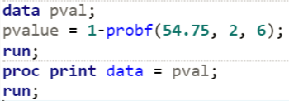

Pure ANOVA, Part VI
7. Now we would like to make an ANOVA table to test the alternative hypothesis!
Formally write the H_{o} and H_{a} and fill in the table.
H₀: µ₁= µ₂ = µ₃ (equal means model µ µ µ)
H_{a}: at least one pair are different (separate means model µ₁ µ₂ µ₃)
 | df | SS | MS | F | Pr > F
Model/extra SS | 2 | 438 | 219 | 54.75 | 0.0001
Error/residual/full Model | 6 | 24 | 4
Total (reduced) | 8 | 462
Extra sum of squares = residual sum of squares reduced – residual sum of squares full

Slide 15
ANOVA in SAS
Screen Share

Slide 16
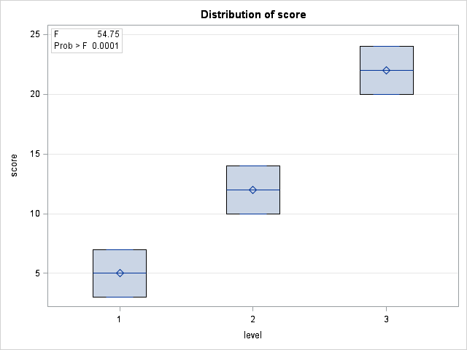
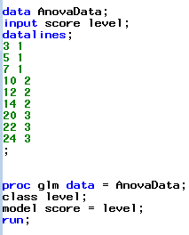
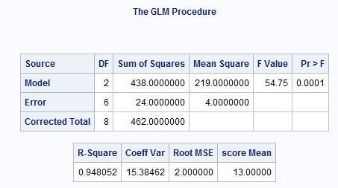
F-Test of Different Means
H₀: µ₁= µ₂ = µ₃ (equal means model)
H_{a}: at least one pair is different (separate means model)

Slide 18
ANOVA as a Six-Step Hypothesis Test

Slide 19
Six Steps for ANOVA F-Test (diff means)!
1.
H₀: µ₁= µ₂ = µ₃ (equal means model)
H_{a}: at least one pair is different (separate means model)
2.
Critical Value =

Slide 20
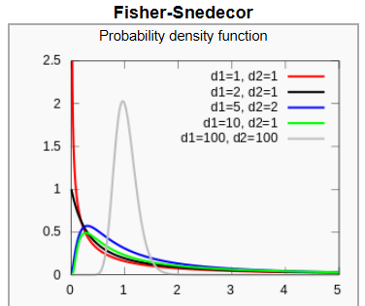
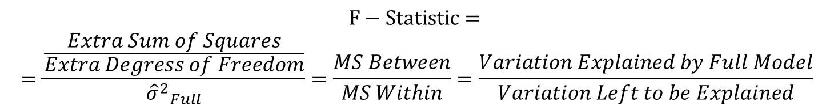
F-Distribution
$$F−Statistic=$$
$$=\frac{\frac{Extra Sum of Squares}{Extra Degress of Freedom}}{{{\hat{σ}}^{2}}_{Full}}=\frac{MS Between}{MS Within}=\frac{Variation Explained by Full Model}{Variation Left to be Explained}$$

Slide 21


Six Steps for ANOVA F-Test (diff means)!
1.
H₀: µ₁= µ₂ = µ₃ (equal means model)
H_{a}: at least one pair is different (separate means model)
2.
df1 = Between (Model) df = 2
Critical Value = 5.14
3.
df2 = Within (Error) df = 6
F statistic = 54.75
4.
P-value = 0.0001
5.
Reject H₀
6.
The evidence suggests that at least one pair of the group means are different (P-value < 0.0001 from an ANOVA)

Slide 23
R-Squared and Other Statistics

Slide 24
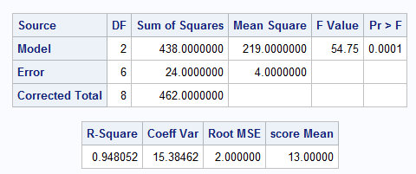
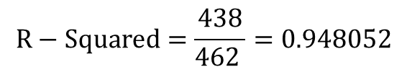
R-Squared!
R = correlation coefficient R² = coefficient of determination
$$R−Squared=\frac{Variation Explained by Full Model}{Total Variation }=\frac{Extra Sum of Squares}{Total Sum of Squares}$$
$$R−Squared=\frac{438}{462 }=0.948052$$
*It is estimated that 94.81% of the variation in the data can be explained by the group membership.

Slide 25
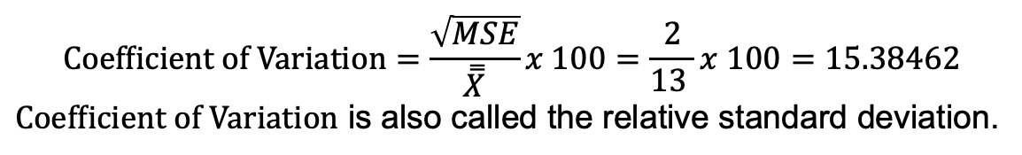
Coefficient of Variation
$$Coefficient of Variation=\frac{square root of the unexplained variation}{grand mean }x 100\%$$
$$Coefficient of Variation=\frac{\sqrt{MSE}}{\overset{̿}{X}}x 100=\frac{2}{13 }x 100=15.38462$$
$Coefficient of Variation$ is also called the relative standard deviation.

Slide 27
Spock Example
Strategy

Slide 28
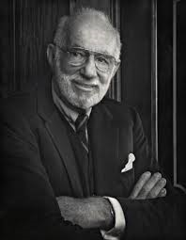
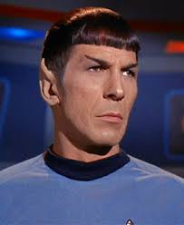
Spock Trial
1968: Dr. Ben Spock was accused of conspiracy to violate the Selective Service Act by encouraging young men to resist being drafted into military service for Vietnam.
Jury selection: A “venire” of 30 potential jurors is selected at random from a list of 300 names that were previously selected at random from citizens of Boston.
A jury is then selected not at random by the attorneys trying the case.
For this case, the venire consisted of only one woman, who was let go by the prosecution, thus resulting in an all male jury.
There was reason to believe that women were more sympathetic to Dr. Spock’s actions due to his popular child-rearing books.
The defense argued that the judge in this case had a history of venires that underrepresented women, which is contrary to the law.
Let’s see if there is any evidence for this claim!

Slide 29
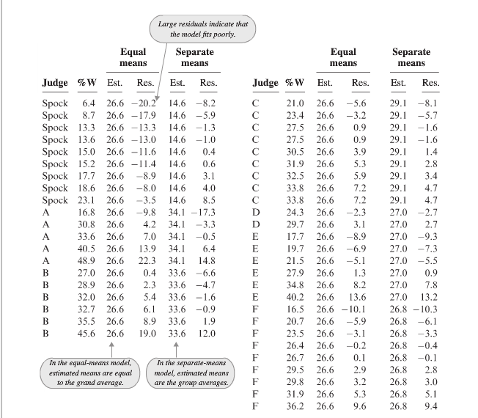
The Raw Data

Slide 30
Spock Trial QOI
The defense argued that the judge in this case had a history of venires that underrepresented women, which is contrary to the law.
QOI: Is the percent of women on recent venires of Spock’s judge (which we will call S) significantly lower than those of six other judges (which we notate A to F)?

Slide 31
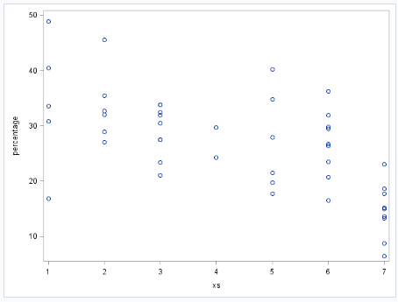
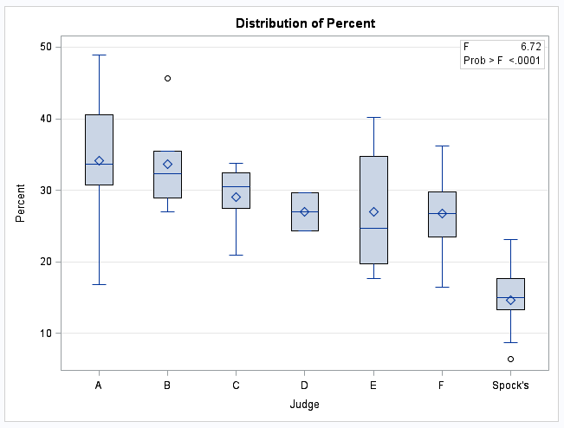

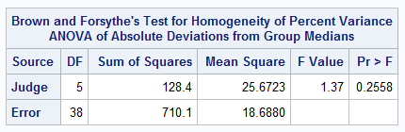

Check of Assumptions: Constant SD
There is some visual evidence against equal standard deviations. The Brown-Forsythe test was used as secondary evidence and does not provide significant evidence against equal standard deviations. (p-value = .2558)

Slide 32
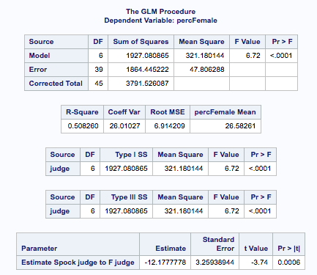
Initial ANOVA
There is overwhelming evidence to suggest that at least one pair of judges have different mean percentage venires (p-value from an ANOVA < 0.0001). The question remains, however. Is there evidence that Spock’s judge’s venires specifically have a lower mean percentage of women than the other six judges?

Slide 33
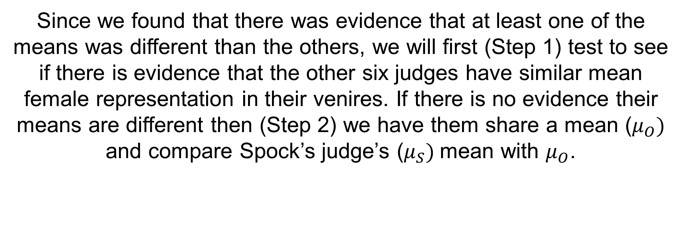
Spock: The Strategy
Since we found that there was evidence that at least one of the means was different than the others, we will first (Step 1) test to see if there is evidence that the other six judges have similar mean female representation in their venires. If there is no evidence their means are different then (Step 2) we have them share a mean ($μ_{O})$ and compare Spock’s judge’s ($μ_{S})$mean with $μ_{O}$.

Slide 35
Spock Example
Step 1

Slide 36
Step 1: Compare Judges A–F
H₀: all “other” means are equal (A, B, C, D, E, F)
H_{a}: at least two “other” means are different (A, B, C, D, E, F)
But … let’s use all the data to estimate the pooled standard deviation!
Reduced model: µ_{s} µ₀ µ₀ µ₀ µ₀ µ₀ µ₀
Full model: µ_{s} µ_{A} µ_{B} µ_{C} µ_{D} µ_{E} µ_{F}

Slide 37
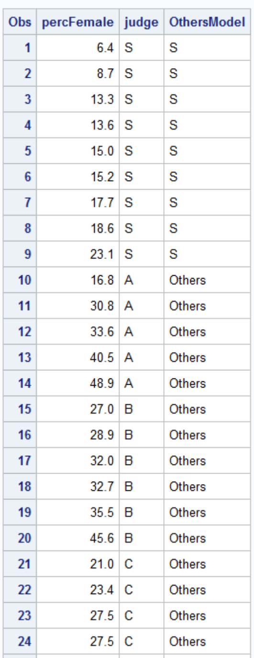
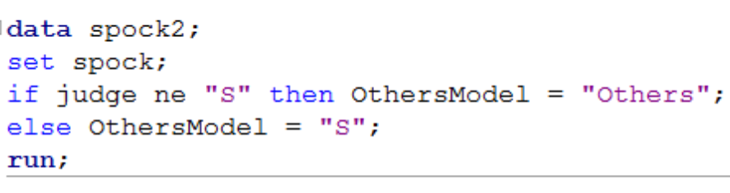
Different Models in SAS
At least two are different (S, A, B, … F)
µ_{s} µ_{A} µ_{B} µ_{C} µ_{D} µ_{E} µ_{F}
Spock is different than the others
µ_{s} µ₀ µ₀ µ₀ µ₀ µ₀ µ₀

Slide 38
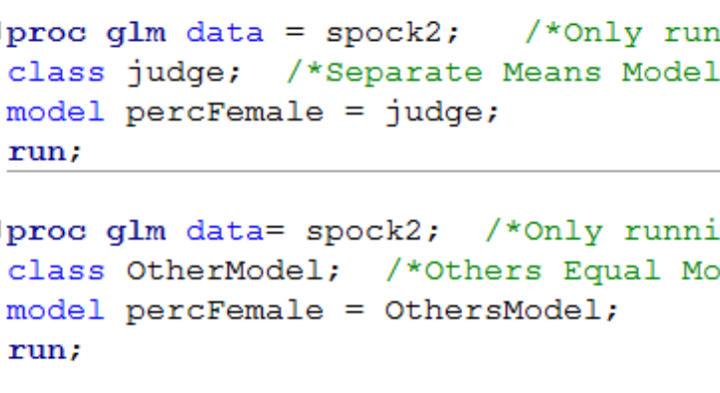
Different Models in SAS (cont.)
At least two are different (S, A, B, … F)
µ_{s} µ_{A} µ_{B} µ_{C} µ_{D} µ_{E} µ_{F}
Spock is different than the others
µ_{s} µ₀ µ₀ µ₀ µ₀ µ₀ µ₀

Slide 39
Comparing Two Models: Both Are Not Equal Means Model
SAS (proc glm) compares models to the equal means model. When you run proc glm, it always makes the “Corrected Total Row” the equal means model. However, we can build our own ANOVA table (BYOA) to compare two models, both of which are not the equal means model.
To do this we will need to identify the “full” model and the “reduced” model. The “full” model will be the model with the most parameters (means) in it while the “reduced model” will have fewer parameters. [Note that the equal means model (with one parameter) is the most reduced model you can have.]
Extra sum of squares
test/BYOA
Source | DF | SS | MS | F | Pr > F
Model
Error
Corrected total
Separate Means model
(full model)
Equal means model
(Reduced model)

Slide 40
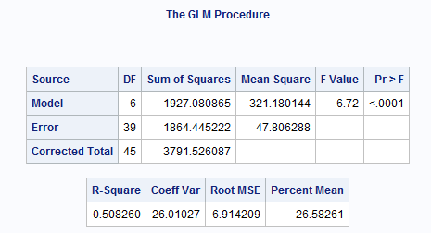
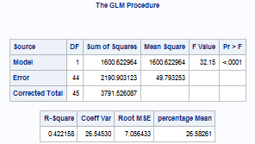
Different Models in SAS (cont.)
At least two are different (S, A, B, … F)
Spock is different than the others
µ_{s} µ_{A} µ_{B} µ_{C} µ_{D} µ_{E} µ_{F}
µ_{s} µ₀ µ₀ µ₀ µ₀ µ₀ µ₀

Slide 41
At least two are different (Spock, A, B, C … F)
Spock is different than others
µ_{s} µ_{A} µ_{B} µ_{C} µ_{D} µ_{E} µ_{F}
µ_{s} µ₀ µ₀ µ₀ µ₀ µ₀ µ₀
F-Test: another look
H₀: µ_{A}, µ_{B}, µ_{C} … µ_{F} are equal
H_{a}: at least two are different (A, B, C … F)
Reduced : µ_{s} µ₀ µ₀ µ₀ µ₀ µ₀ µ₀
Full: µ_{s} µ_{A} µ_{B} µ_{C} µ_{D} µ_{E} µ_{F}
Source | DF | SS | MS | F | Pr > F
Model | 5 | 326.5 | 65.29 | 1.37 | 0.26
Error | 39 | 1864.4 | 47.81
Corrected total | 44 | 2190.9
Full
Reduced

Slide 42
H₀: all “other” means are equal (A, B, C, D, E, F)
H_{a}: at least two “other” means are different (A, B, C, D, E, F)
Source | DF | SS | MS | F | Pr > F
Model | 5 | 326.5 | 65.29 | 1.37 | 0.26
Error | 39 | 1864.4 | 47.81
Corrected total | 44 | 2190.9
Full
Reduced
There is not sufficient evidence at the alpha = 0.05 level of significance (p-value = 0.26) to suggest that the means are not equal. Therefore, we will proceed as if they are equal. We will proceed as if the mean percent of women on judge’s A – F are equal and proceed to compare those to the mean percent of women on Spock’s venire.

Slide 43
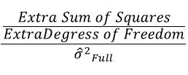


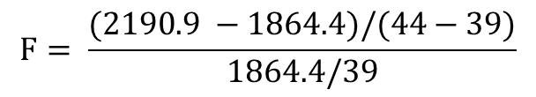

Extra sums of squares F-Test
F-Test
H₀: all means are equal (Spock, A, B, C, … ,F)
H₀: µ_{A} – µ_{F} are equal
H_{a}: at least two are different (Spock, A, B, … ,F)
H_{a}: at least two are different (A, B, … F)
$$F=$$
$$F= \frac{(2190.9 −1864.4)/(44−39)}{1864.4/39}$$
$$F=1.37$$
H₀: Spock is equal to others
P-value = $0.26$
H_{a}: Spock is different from others
Fail to Reject H₀
There is not sufficient evidence at the alpha = 0.05 level of significance (p-value = 0.26) to suggest that the means are not equal. Therefore, we will proceed as if they are equal.

Slide 44
Step 1 Complete!
There is not sufficient evidence to suggest that the mean percent of women on judge’s A–F venires are different from one another (p-value = 0.26 from an ANOVA). Therefore, we will now move on to Step 2 and compare Spock’s judge’s mean to the single mean that will represent the other judges.
F-Test: another look
H₀: µ_{A}, µ_{B}, µ_{C} … µ_{F} are equal
H_{a}: at least two are different (A, B, C, … F)
Source | DF | SS | MS | F | Pr > F
Model | 5 | 326.5 | 65.29 | 1.37 | 0.26
Error | 39 | 1864.4 | 47.81
Corrected total | 44 | 2190.9

Slide 46
Spock Example
Step 2

Slide 47
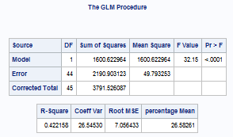
Step 2!
Since we are proceeding under the assumption that the mean percentage of women in venires of the non-Spock judges are equal, we can test whether the Spock judge has a mean percentage different than the other judges by testing:
H₀: mean of Spock is equal to the mean of the others
H_{a}: mean of Spock is different than the mean others
There is strong evidence at the alpha = 0.05 level of significance (p-value < 0.0001 from an ANOVA) to support the claim that the mean percentage of women in the Spock judge’s venires is less than that of the other six judges and that there is no evidence that the other six judges have different mean percentages of women on their venires (p-value = 0.26 from an extra sum of squares F-Test). Spock’s lawyer has evidence for a mistrial.

Slide 49
Archeology: Introduction and Four Questions of Interest (QOIs)

Slide 50
Archeology in New Mexico
An archeological dig in New Mexico yielded four sites with lots of artifacts. The depth (cm) that each artifact was found was recorded along with which site it was found in.
The researcher has reason to believe that sites 1 and 4 and sites 2 and 3 may be similar in age. In theory, the deeper the find, the older the village.
Is there any evidence that sites 1 and 4 have a mean depth that is different than the mean depth of artifacts from sites 2 and 3?

Slide 51
Archeology Example
Depth | Site |  | Depth | Site |  | Depth | Site |  | Depth | Site
93 | 1 |  | 85 | 2 |  | 100 | 3 |  | 96 | 4
120 | 1 |  | 45 | 2 |  | 75 | 3 |  | 58 | 4
65 | 1 |  | 80 | 2 |  | 65 | 3 |  | 95 | 4
105 | 1 |  | 28 | 2 |  | 40 | 3 |  | 90 | 4
115 | 1 |  | 75 | 2 |  | 73 | 3 |  | 65 | 4
82 | 1 |  | 70 | 2 |  | 65 | 3 |  | 80 | 4
99 | 1 |  | 65 | 2 |  | 50 | 3 |  | 85 | 4
87 | 1 |  | 55 | 2 |  | 30 | 3 |  | 95 | 4
100 | 1 |  | 50 | 2 |  | 45 | 3 |  | 82 | 4
90 | 1 |  | 40 | 2 |  | 50 | 3
78 | 1 |  |  |  |  | 45 | 3
95 | 1 |  |  |  |  | 55 | 3
93 | 1
88 | 1
110 | 1

Slide 52
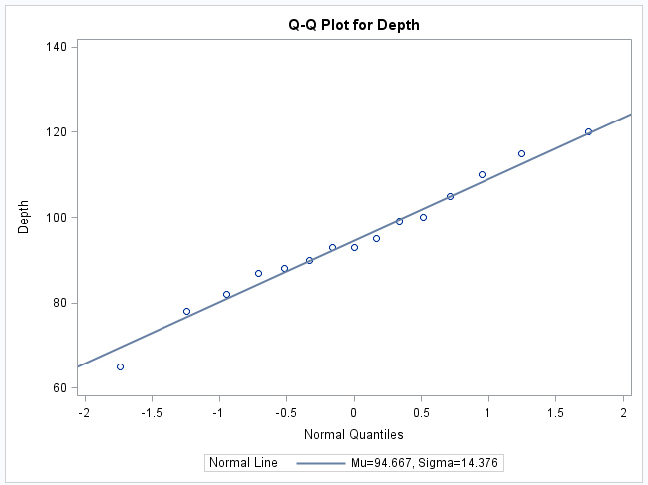
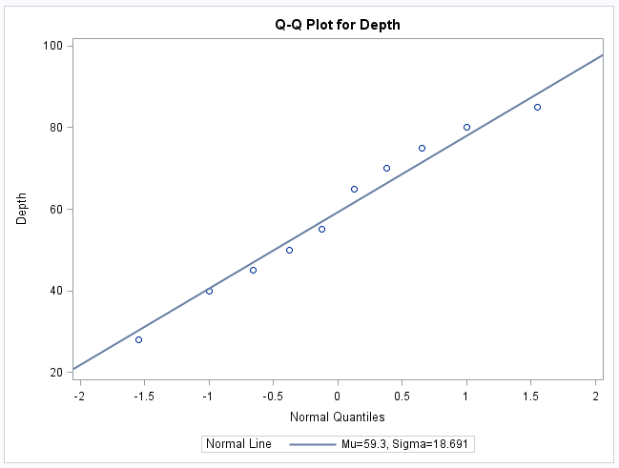
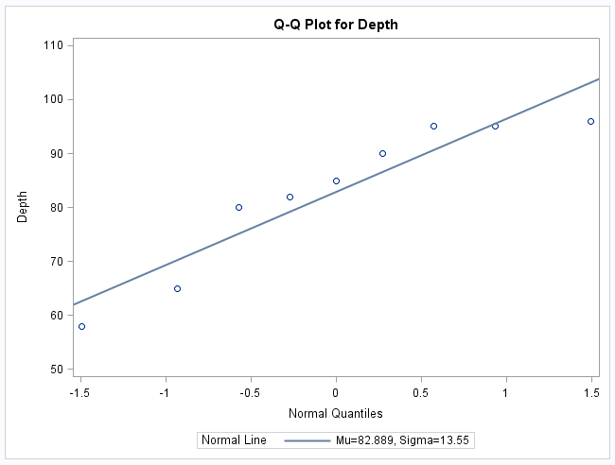
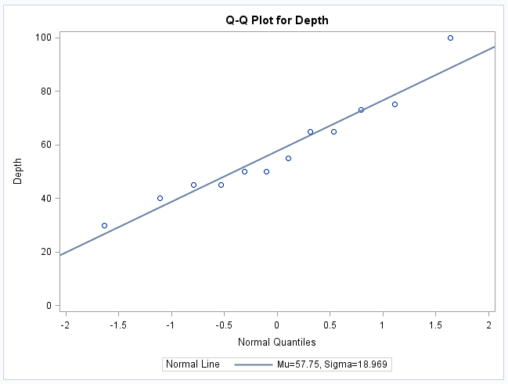
Archeology Example Assumptions: Normality
Histograms will be helpful as well!

Slide 53
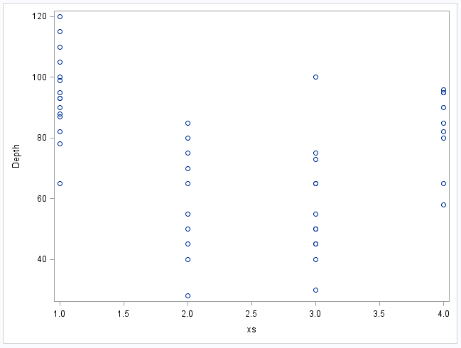
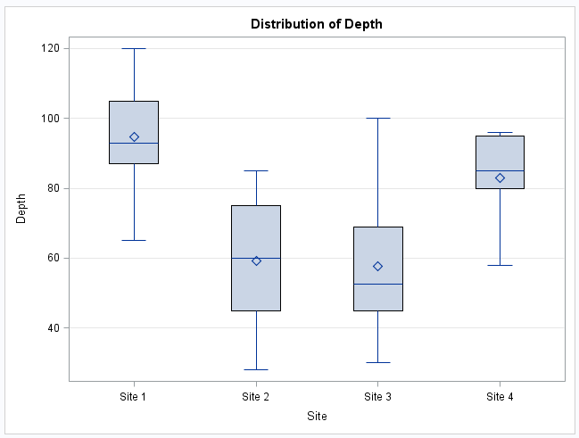
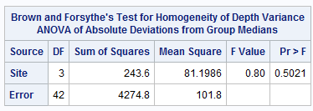
Archeology Example Assumptions: Homogeneity (Equal SD)

Slide 54
Archeology Example Assumption: Independence
The discovered artifacts associated with the depths were randomly selected from the log (book of recordings … not logarithms!) of discoveries.
Since the artifacts and, thus, the depths are associated with completely different sites, it is assumed that the data are independent between sites.

Slide 55
Question of Interest
1. Are any of the means different?
2. Are the means of sites 1 and 4 different? 3. Are the means of sites 2 and 3 different?
4. Satisfactory results of questions 1 and 2 will allow us to ask the third question: Are sites 1 and 4 different than 2 and 3?

Slide 57
Are sites 1 and 4 different from 2 and 3? *Assumes ANOVA assumptions are met
Perform regular ANOVA to test if any of the means are different from the rest
Reduced model H₀: µ µ µ µ
Full model H_{a}: µ₁ µ₂ µ₃ µ₄
BYO ANOVA to test if the means of 2 and 3 are different, given at least one pair is different
Reduced model H₀: µ₁ µ₀ µ₀ µ₄
Full model H_{a}: µ₁ µ₂ µ₃ µ₄
Stop: groups 2 and 3 are different and should not be treated as having the same means, as the QOI suggests
Stop: insufficient evidence that any means are different
Reject H₀ in favor of H_{a}: µ₁ µ₂ µ₃ µ₄?
Reject H₀ in favor of H_{a}: µ₁ µ₂ µ₃ µ₄?
no
yes
yes
no
BYO ANOVA to test if the means of 1 and 4 are different, given at least one pair is different
Reduced model H₀: µ₀ µ₂ µ₃ µ₀
Full model H_{a}: µ₁ µ₂ µ₃ µ₄
Perform ANOVA to test if the means of 1 and 4, when taken together are different than means 2 and 3, when also taken together
Reduced model H₀: µ µ µ µ
Full model H_{a}: µ_{a} µ_{b} µ_{b} µ_{a}
Stop: groups 1 and 4 are different and should not be treated as having the same means, as the QOI suggests
Stop: evidence does not support the claim in QOI
yes
Reject H₀ in favor of H_{a}: µ₁ µ₂ µ₃ µ₄?
Reject H₀ in favor of H_{a}: µ_{a} µ_{b} µ_{b} µ_{a}?
no
Stop: evidence does support the claim in QOI
no
yes

Slide 58
QOI 1

Slide 59
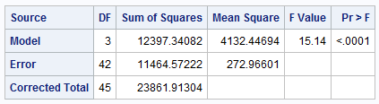
First Ask: Is There Reason to Believe Any of Them Are Different?
(H₀) Reduced model: µ µ µ µ
(H_{a}) Full model: µ₁ µ₂ µ₃ µ₄
There is strong evidence to suggest that at the alpha = 0.05 level of significance (p-value < 0.0001) that at least two of the sites have different mean depths.

Slide 61
QOI 2

Slide 62
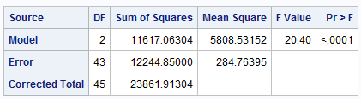
Question of Interest 2: Are the Means of Sites 1 and 4 Different?
Compare this model against equal means model (µ µ µ µ)
*Recode the variables into three groups: 2, 3, and 1/4 combined and perform ANOVA to get the first table.
(H₀) Reduced model: µ₀ µ₂ µ₃ µ₀
(H_{a}) Full model: µ₁ µ₂ µ₃ µ₄
Compare this model against equal means model (µ µ µ µ)
(H₀) Reduced: µ µ µ µ
(H₀) Reduced: µ µ µ µ
(H_{a}) Full*: µ₀ µ₂ µ₃ µ₀
(H_{a}) Full: µ₁ µ₂ µ₃ µ₄
There is not enough evidence to suggest (alpha = 0.05, p-value = 0.098) that site 1 and site 4 have different mean depths.
Source | DF | SS | MS | F | Pr > F
Model (full) | 1 | 780.3 | 780.3 | 2.86 | .098
Error (from full) | 42 | 11464.6 | 273.0
Total (from reduced*) | 43 | 12244.9

Slide 64
QOI 3

Slide 65
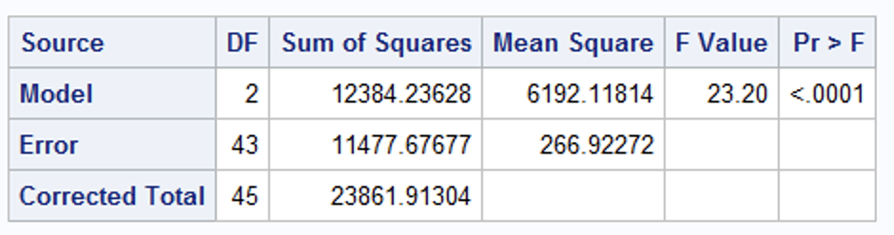
Question of Interest 3: (Try It!) Are the Means of Sites 2 and 3 Different? Part I
*Recode the variables into three groups: 1, 4, and 2/3 combined and perform ANOVA to get the first table.
(H₀) Reduced model:
µ₁ µ₀ µ₀ µ₄
(H_{a}) Full model:
µ₁ µ₂ µ₃ µ₄
(H₀) Reduced:
µ µ µ µ
(H₀) Reduced:
µ µ µ µ
(H_{a}) Full*:
µ₁ µ₀ µ₀ µ₄
(H_{a}) Full:
µ₁ µ₂ µ₃ µ₄
Source | DF | SS | MS | F | Pr > F
Model (full)
Error (from full)
Total (from reduced*)

Slide 66
Question of Interest 3: (Try It!) Are the Means of Sites 2 and 3 Different? Part II
*Recode the variables into three groups: 1, 4, and 2/3 combined and perform ANOVA to get the first table.
(H₀) Reduced model:
µ₁ µ₀ µ₀ µ₄
(H_{a}) Full model:
µ₁ µ₂ µ₃ µ₄
(H₀) Reduced:
µ µ µ µ
(H₀) Reduced:
µ µ µ µ
(H_{a}) Full*:
µ₁ µ₀ µ₀ µ₄
(H_{a}) Full:
µ₁ µ₂ µ₃ µ₄
Source | DF | SS | MS | F | Pr > F
Model (full)
Error (from full) | 42 | 11464.6 | 273
Total (from reduced*) | 43 | 11477.7

Slide 67
Question of Interest 3: (Try It!) Are the Means of Sites 2 and 3 Different? Part III
*Recode the variables into three groups: 1, 4, and 2/3 combined and perform ANOVA to get the first table.
(H₀) Reduced model:
µ₁ µ₀ µ₀ µ₄
(H_{a}) Full model:
µ₁ µ₂ µ₃ µ₄
(H₀) Reduced:
µ µ µ µ
(H₀) Reduced:
µ µ µ µ
(H_{a}) Full*:
µ₁ µ₀ µ₀ µ₄
(H_{a}) Full:
µ₁ µ₂ µ₃ µ₄
Source | DF | SS | MS | F | Pr > F
Model (full) | 1 | 13.1 | 13.1 | 0.048 | 0.828
Error (from full) | 42 | 11464.6 | 273
Total (from reduced*) | 43 | 11477.7
There is not enough evidence to suggest (alpha = 0.05, p-value = 0.828) that site 2 and site 3 have different mean depths.

Slide 69
QOI 4

Slide 70
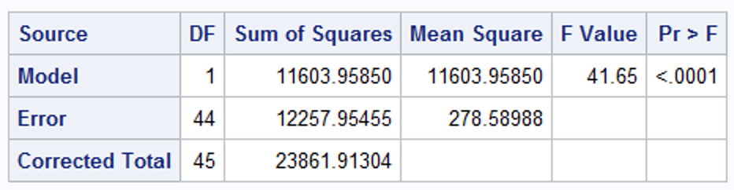
Question of Interest 4: Are Sites 1 and 4 Different Than 2 and 3?
*Recode the variables into two groups 1/4 and 2/3 and perform ANOVA to get the table.
(H₀) Reduced: µ µ µ µ
(H_{a}) Full: µ_{b} µ_{a} µ_{a} µ_{b}
There is sufficient evidence to suggest (alpha = 0.05, p-value < 0.0001) that sites 1 and 4 have different mean depths than sites 2 and 3.

Slide 72
ANOVA: Assumptions and Robustness

Slide 73
ANOVA: Assumptions and Robustness
Normality: Similar to t-tools hypothesis testing, ANOVA is robust to this assumption. Extremely long-tailed distributions (outliers) or skewed distributions, coupled with different sample sizes (especially when the sample sizes are small) present the only serious distributional problems.
Equal standard deviations: This assumption is crucial, paramount, and very important.
The assumptions of independence within and across groups is critical if this assumption is “significantly” violated. Many, if not most (if not all), samples have some level of correlation in them. Certainly, the more this assumption is violated the worse the test will perform.

Slide 74
Samples Drawn from Normal Distributions
Same visual checks as with t-tools, just for more groups
Histograms
Box Plots
Q-Q plots

Slide 75

More on Constant SD
Ninety-five percent confidence interval accuracy with different sample sizes and standard deviations for three groups

Slide 77
Welch’s ANOVA

Slide 78





Another Analysis!
…

Slide 79



Normality Assumption
There is strong evidence in favor of these data coming from a normal distribution. We will proceed under this assumption.

Slide 80





Assumptions and Analysis
There is strong evidence in support of these data coming from distributions with different standard deviations. We will proceed under this assumption and run the Welch’s ANOVA.
Regular ANOVA
There is sufficient evidence at the alpha = 0.05 level of significance (p-value = 0.0201 from Welch’s ANOVA) to suggest that at least two of the means are different.

Slide 82
Performance of Welch’s ANOVA
Simulation

Slide 83


Performance of Welch’s Test

Slide 85
Kruskal-Wallis Test

Slide 86




A Small Example

Slide 87







Normality Assumption
There is strong evidence against these data coming from a normal distribution, and the sample size is small. ANOVA? Welch’s ANOVA?

Slide 88



Homogeneity of Variance Assumption
There is some evidence in support of these data coming from distributions with different standard deviations. If the standard deviation assumption and normality assumption are both violated, what should we do?

Slide 89

So … Nonparametric!

Slide 90



Kruskal-Wallis Test
There is not sufficient evidence at the alpha = 0.05 level of significance (p-value = 0.3766 from Kruskal-Wallis Test) to suggest that at least two of the medians are different.
Notice that each test failed to reject their respective H_{o}. The point isn’t so much that one test will reject when the other will fail to reject. We must remember that, as statisticians, we don’t personally favor one outcome over the other. We just want the appropriate test: the one with the most power. Kruskal-Wallis Test is the most appropriate test.

Slide 92
Appendix

Slide 93
Fixed Effects vs. Random Effects
Quick answer
Do your groupings exhaust the data (e.g., data on four different machines and there are only four machines)? Fixed effects! Use Proc GLM in SAS.
Are your groupings a random sample of a larger population that could have been chosen to be a group (e.g., data on four different machines that were chosen from a random sample of 100 machines)? Random effects! Use Proc Mixed in SAS.

Slide 94
Fixed or Random Effects
Measured the amount of liquid in 20 randomly selected cans of Coke and 20 randomly selected cans of Diet Coke at a regional bottling company. Coke and Diet Coke are bottled using different types of machines.
Scenario 1: There is only one machine of each type.
Fixed effects
Scenario 2: There are several of each type of machine. The Coke samples all came from the same Coke bottling machine, and the Diet Coke samples all came from the same Diet Coke machine.
Random effects

Slide 95


What Does $r^{2}$ Mean? Part I
$r^{2}$ is called the coefficient of determination, or square of the correlation coefficient
$r^{2}=\frac{{SS}_{model}}{{SS}_{total}}$
We can think of $r^{2}$ as the proportion of variability that is explained by the independent variables (grouping data)

Slide 96


What Does $r^{2}$ Mean? Part II
While $r^{2 }$is gleaned from the data, the true parameter is referred to as $ρ$ (rho).
The following two hypothesis tests are equivalent:
1
$$H_{0}: μ_{1}=μ_{2}=⋯=μ_{k}$$
$$H_{1}:at least 1 μ_{i} is different$$
Test statistic
$F=\frac{MS(model)}{MS(error)}$, where $F$ is $F−$distributed with $k−1$, $n−k$ degrees of freedom
2
$$H_{0}: ρ=0$$
$$H_{1}:ρ≠0$$
Test statistic
$F=\frac{r^{2}(n−k)}{\left(1−r^{2}\right)\left(k−1\right)}$, where $F$ is $F−$distributed with $k−1$, $n−k$ degrees of freedom
You can use algebra to prove the two test statistics are equivalent. Try it yourself!

Slide 97


What Does $r^{2}$ Mean? Part III
Let $F_{1}=\frac{r^{2}(n−k)}{\left(1−r^{2}\right)\left(k−1\right)}$ and $F_{2}=\frac{MS(model)}{MS(error)}$, where $k$ is the number of groups and $n$ is the total number of data points.
Recall that:
$r^{2}=\frac{{SS}_{model}}{{SS}_{total}}=\frac{{SS}_{total}−{SS}_{error}}{{SS}_{total}}=1−\frac{{SS}_{error}}{{SS}_{total}}$.
So, $1−r^{2}=\frac{{SS}_{error}}{{SS}_{total}}$.
Also remember that $MS\left(model\right)=\frac{SS(model)}{k−1}$ and $MS\left(error\right)=\frac{SS(error)}{n−k}$.
$$\frac{r^{2}(n−k)}{\left(1−r^{2}\right)\left(k−1\right)}=\frac{\frac{{SS}_{model}}{{SS}_{total}}(n−k)}{\frac{{SS}_{error}}{{SS}_{total}}\left(k−1\right)}=\frac{{SS}_{model}(n−k)}{{SS}_{error}\left(k−1\right)}=\frac{{SS}_{model}/(k−1) }{{SS}_{error}/\left(n−k\right)}=\frac{MS(model)}{MS(error)}$$
Therefore, $F_{1}=F_{2}$.

Slide 98

MSE vs. Variance in Each Group
MSE is a weighted average of the sample variances of each group. Let $s_{i}^{2}$ be the sample variance in group $i$.
$MSE=s_{p}^{2}=\frac{\left(n_{1}−1\right)s_{1}^{2}+\left(n_{2}−1\right)s_{2}^{2}+⋯+\left(n_{k}−1\right)s_{k}^{2}}{\left(n_{1}−1\right)+\left(n_{2}−1\right)+⋯+\left(n_{k}−1\right)}$
$$MSE=\frac{\left(n_{1}−1\right)s_{1}^{2}+\left(n_{2}−1\right)s_{2}^{2}+⋯+\left(n_{k}−1\right)s_{k}^{2}}{n−k}$$

Slide 100
Examples

Slide 101

Another Example!
Five different sports were analyzed to see if the average height of basketball players was greater than the average of all the other sports. We could, of course, compare each pairwise grouping of sports, but that would result in four tests. This would take a lot of time, and those tests would each have less power since they don’t use all the data. Let’s use ANOVA similarly to how we did in prior problems.
Make a side-by-side box plot of the data.
Run a basic ANOVA to test for any pairwise difference of means. Check the assumptions here, but no need to address them after this.
Test the model that keeps basketball by itself but groups the other sports as “others.”
Use the previous two models to conduct an extra sum of squares F-Test:
Depending on the results of this test, test to see if there is evidence that basketball has a different mean than each of the sports. (equivalent to testing basketball vs. the others)
Make sure and provide written conclusions for questions 2, 3, 4, and 5.
H_{o}: reduced model: µ_{B} µ_{O} µ_{O} µ_{O} µ_{O}
H_{a}: full model: µ_{B} µ_{F} µ_{Soc} µ_{Swim} µ_{T}
H_{o}: reduced model: µ_{O} µ_{O} µ_{O} µ_{O} µ_{O}
H_{a}: full model: µ_{B} µ_{O} µ_{O} µ_{O} µ_{O}

Slide 102

First … Plot the Data!

Slide 103











Plot the Data (cont.)
Normality: We have very small sample sizes here. There is not a lot of evidence against normality for each group, although there is not a lot of evidence to begin with. We will proceed with caution under the assumption of normal distributions for each sport.
Homogeneity of variance: Judging from the box plots, there is some visual evidence against equal standard deviations, although the sample size is still small. A secondary test would be nice to lean on here.
We will assume the observations are independent both between and within groups.

Slide 104

Brown and Forsythe Test for Equality of Variance
There is some visual evidence against equal standard deviations between sports. The Brown and Forsythe test was used as secondary evidence and does not provide significant evidence against equal standard deviations. (p-value =0 .9672)

Slide 105


1 Way ANOVA
H₀: µ_{Basketball} = µ_{Football}= µ_{Soccer} = µ_{Swim} = µ_{Tennis}
H_{a}: at least one pair of means is different
There is strong evidence to suggest that at least one of the sports has a mean height that is different than the others (p-value < 0.0001 from an ANOVA).

Slide 106






H₀: µ_{Basketball} = µ_{Football}= µ_{Soccer} = µ_{Swim} = µ_{Tennis}
H_{a}: at least one pair of means are different
F-Test
H₀: the others are equal (including basketball)
H_{a}: the others are different (including basketball)
$$F=$$
$$F= \frac{(153.19 −141.56)/(30−27)}{141.56/27}$$
H₀: µ_{Basketball} = µ_{Football}= µ_{Soccer} = µ_{Swim} = µ_{Tennis}
H_{a}: µ_{Basketball} is different than the others
$$F=.74$$
P-value = $0.5375$
Fail to Reject Ho
There is not sufficient evidence at the alpha = 0.05 level of significance (p-value = 0.5375) to suggest that the mean heights of non-basketball sports are not equal. Therefore, we will proceed as if they are equal.

Slide 107

H₀: reduced model: µ µ µ µ µ
H_{a}: full model: µ_{B} µ_{F} µ_{Soc} µ_{Swim} µ_{T}
Same test as last slide …
different notation
F-Test
H₀: reduced model: µ_{B} µ_{O} µ_{O} µ_{O} µ_{O}
H_{a}: full model: µ_{B} µ_{F} µ_{Soc} µ_{Swim} µ_{T}
$$F=$$
$$F= \frac{(153.19 −141.56)/(30−27)}{141.56/27}$$
H₀: reduced model: µ µ µ µ µ
H_{a}: full Model: µ_{B} µ_{O} µ_{O} µ_{O} µ_{O}
$$F=.74$$
P-value = $0.5375$
Fail to Reject Ho
There is not sufficient evidence at the alpha = 0.05 level of significance (p-value = 0.5375) to suggest that the mean heights of non-basketball sports are not equal. Therefore, we will proceed as if they are equal.

Slide 108
µ_{B} µ_{F} µ_{Soc} µ_{Swim} µ_{T}
µ_{B} µ₀ µ₀ µ₀ µ₀
F-Test: another look
H₀: reduced model: µ_{B} µ₀ µ₀ µ₀ µ₀
H_{a}: full model: µ_{B} µ_{F} µ_{Soc} µ_{Swim} µ_{T}
Source | DF | SS | MS | F | Pr > F
Model | 3 | 11.63 | 3.87 | 0.74 | 0.5375
Error | 27 | 141.56 | 5.24
Corrected total | 30 | 153.19

Slide 109
Since we are proceeding under the assumption that the mean heights of the other sports (besides basketball) are equal, we can test whether basketball has a mean height different than the other sports by testing:
H₀: µ_{Basketball} = µ_{Others}
H_{a}: µ_{Basketball} ≠ µ_{Others}
There is strong evidence at the alpha = 0.05 level of significance (p-value < 0.0001) that supports the claim that the mean height of basketball players is different than that of the other four sports.

Slide 110
Resources
www.itl.nist.gov/div898/handbook/prc/section4/prc433.htm

Slide 112
Spock Example

Slide 113
Spock Trial
1968: Dr. Ben Spock was accused of conspiracy to violate the Selective Service Act by encouraging young men to resist being drafted into military service for Vietnam.
Jury selection: A “venire” of 30 potential jurors is selected at random from a list of 300 names that were previously selected at random from citizens of Boston.
A jury is then selected not at random by the attorneys trying the case.
For this case, the venire consisted of only one woman, who was let go by the prosecution, thus resulting in an all male jury.
There was reason to believe that women were more sympathetic to Dr. Spock’s actions due to his popular child-rearing books.
The defense argued that the judge in this case had a history of venires that underrepresented women, which is contrary to the law.
Let’s see if there is any evidence for this claim!

Slide 114
The Raw Data

Slide 115






Comparing Two Means from Many Groups
H₀: µ_{S} = µ_{F}
H_{a}: µ_{S} ≠ µ_{F}
Judge | N | Xbar | SD
Spock | 9 | 14.6 | 5.04
A | 5 | 34.1 | 11.94
B | 6 | 33.6 | 6.58
C | 9 | 29.1 | 4.59
D | 2 | 27.0 | 3.81
E | 6 | 27.0 | 9.01
F | 9 | 26.8 | 5.97
With two groups estimating the pooled SD.
$$t=\frac{{\overline{x}}_{1}−{\overline{x}}_{2}}{s_{p}\sqrt{\frac{1}{n_{1}}+\frac{1}{n_{2}}}}$$
$$CV=t_{.025,16}=±2.12$$
With all seven groups estimating the pooled SD, bigger ‘n’ greater df! More power!
$$s_{p}=\sqrt{\frac{\left(9−1\right)∗{5.04}^{2}+\left(5−1\right)∗{11.94}^{2}+\left(6−1\right)∗{6.58}^{2}+\left(9−1\right)∗{4.59}^{2}+\left(2−1\right)∗{3.81}^{2}+\left(6−1\right)∗{9.01}^{2}+\left(9−1\right)∗{5.97}^{2}}{\left(9−1\right)+(5−1)+(6−1)+(9−1)+(2−1)+(6−1)+(9−1)}}$$
s_{p} = 6.91
$$CV=t_{.025,39}=±2.02$$
$$t=\frac{14.6−26.8}{6.91\sqrt{\frac{1}{9}+\frac{1}{9}}}=\frac{−12.2}{3.25}=−3.75$$
P-value = 0.0006
Reject $H_{0}$

Slide 116


Spock Data Steps
Question: Suppose we wish to test if the “S” judge’s venires are different from the “F” judge’s.

Slide 117


Two-Judge Analysis with T-Tools
Statistical conclusion: We find that there is substantial evidence that the difference in the mean percentage of females on judge S and judge F venires is not equal to zero.
Estimated diff = –12.1778
S_{p} = 5.5234
Pooled std. error = 2.6038
t-Statistic = –4.68
Deg. of freedom = 16

Slide 118

Two-Judge Analysis with Several Groups
From PROC T-Test:
Estimated diff = –12.1778
S_{p} = 5.5234
Pooled std. error = 2.6038
t-Statistic = –4.68
Deg. of freedom = 16
Deg. of freedom = 46 – 7 = 39

Slide 119
Two-Judge Analysis: Conclusion
Question: Suppose we wish to test if the “S” judge’s venires are different from the “F” judge’s.
Answer: There is evidence that the mean of the two groups is different.
We can use regular t-tools or several-group analysis.
The several-group analysis allows us to use all of the available information—larger degrees of freedom—more power!

Slide 120
Spock Trial QOI 2
The defense argued that the judge in this case had a history of venires that underrepresented women, which is contrary to the law.
QOI2: Is the percent of women on recent venires of Spock’s judge (which we will call S) significantly lower than those of six other judges (which we notate A to F)?
There are two key questions
Is there evidence that women are underrepresented on S’s venires relative to A to F’s?
Is there evidence of a difference in women’s representation on A to F’s venires?
The question of interest is addressed by 1
The strength of the result in 1 would be substantially diminished if 2 is true

Slide 121

Spock: The Strategy
Since we found that there was evidence that at least one of the means was different than the others, we will first (Step 1) test to see if there is evidence that the other six judges have similar mean female representation in their venires. If there is no evidence their means are different then (Step 2) we have them share a mean ($μ_{O})$ and compare Spock’s judge’s ($μ_{S})$mean with $μ_{O}$.

Slide 122
Step 1: Compare Judges A–F
H₀: all “other” means are equal (A, B, C, D, E, F)
H_{a}: at least two “other” means are different (A, B, C, D, E, F)
But … Let’s use all the data to estimate the pooled standard deviation!
Reduced model: µ_{s} µ₀ µ₀ µ₀ µ₀ µ₀ µ₀
Full model: µ_{s} µ_{A} µ_{B} µ_{C} µ_{D} µ_{E} µ_{F}

Slide 123
Different Models in SAS
At least two are different (S, A, B, … F)
µ_{s} µ_{A} µ_{B} µ_{C} µ_{D} µ_{E} µ_{F}
Spock is different than the others
µ_{s} µ₀ µ₀ µ₀ µ₀ µ₀ µ₀

Slide 124
Different Models in SAS (cont.)
At least two are different (S, A, B, … F)
µ_{s} µ_{A} µ_{B} µ_{C} µ_{D} µ_{E} µ_{F}
Spock is different than the others
µ_{s} µ₀ µ₀ µ₀ µ₀ µ₀ µ₀

Slide 125
Comparing Two Models: Both Are Not Equal Means Model
SAS (proc glm) compares models to the equal means model. When you run proc glm, it always makes the “Corrected Total Row” the equal means model. However, we can build our own ANOVA table (BYOA) to compare two models, both of which are not the equal means model.
To do this we will need to identify the “full” model and the “reduced” model. The “full” model will be the model with the most parameters (means) in it while the “reduced model” will have fewer parameters. [Note that the equal means model (with one parameter) is the most reduced model you can have.]
Extra sum of squares
Test/BYOA
Source | DF | SS | MS | F | Pr > F
Model
Error
Corrected total
Separate Means model
(full model)
Equal means model
(Reduced model)

Slide 126
At least two are different (Spock, A, B, C, … F)
Spock is different than others
µ_{s} µ_{A} µ_{B} µ_{C} µ_{D} µ_{E} µ_{F}
µ_{s} µ₀ µ₀ µ₀ µ₀ µ₀ µ₀
F-Test: another Look
H₀: µ_{A}, µ_{B}, µ_{C} … µ_{F} are equal
H_{a}: at least two are different (A, B, C, … F)
Reduced : µ_{s} µ₀ µ₀ µ₀ µ₀ µ₀ µ₀
Full: µ_{s} µ_{A} µ_{B} µ_{C} µ_{D} µ_{E} µ_{F}
Source | DF | SS | MS | F | Pr > F
Model | 5 | 326.5 | 65.29 | 1.37 | 0.26
Error | 39 | 1864.4 | 47.81
Corrected total | 44 | 2190.9
Full
Reduced

Slide 127
Extra sums of squares F-Test
F-Test
H₀: all means are equal (Spock, A, B, C, … ,F)
H₀: µ_{A} – µ_{F} are equal
H_{a}: at least two are different (Spock, A, B, … , F)
H_{a}: At least two are different (A,B, ... F)
$$F=$$
$$F= \frac{(2190.9 −1864.4)/(44−39)}{1864.4/39}$$
$$F=1.37$$
H₀: Spock is equal to others
P-value = $0.26$
H_{a}: Spock is diff from others
Fail to Reject H₀
There is not sufficient evidence at the alpha = 0.05 level of significance (p-value = 0.26) to suggest that the means are not equal. Therefore, we will proceed as if they are equal.

Slide 128
Step 1 Complete!
There is not sufficient evidence to suggest that the mean percent of women on judge’s A–F venires are different from one another (p-value = 0.26 from an ANOVA). Therefore, we will now move on to Step 2 and compare Spock’s judge’s mean to the single mean that will represent the other judges.
F-Test: another look
H₀: µ_{A}, µ_{B}, µ_{C}, … µ_{F} are equal
H_{a}: At least two are different (A,B,C …F)
Source | DF | SS | MS | F | Pr > F
Model | 5 | 326.5 | 65.29 | 1.37 | 0.26
Error | 39 | 1864.4 | 47.81
Corrected total | 44 | 2190.9

Slide 129
Step 2!
Since we are proceeding under the assumption that the mean percentage of women in venires of the non-Spock judges are equal, we can test whether the Spock judge has a mean percentage different than the other judges by testing:
H₀: mean of Spock is equal to the mean of the others
H_{a}: mean of Spock is different than the mean others
There is strong evidence at the alpha = 0.05 level of significance (p-value < 0.0001 from an ANOVA) to support the claim that the mean percentage of women in the Spock judge’s venires is less than that of the other six judges and that there is no evidence that the other six judges have different mean percentages of women on their venires (p-value = 0.26 from an extra sum of squares F-Test). Spock’s lawyer has evidence for a mistrial.

